Slide 1
Introduction to Computer Programming
Ms. Mills

Slide 2
Name Cards
LEAP
Computer #
First Name

Slide 3
Objective
Understand the difficulty of translating real problems into programs
Lean that ideas may feel clear and yet still be misinterpreted by a computer
Practice communicating ideas through codes and symbols

Slide 4
Vocabulary

Slide 5
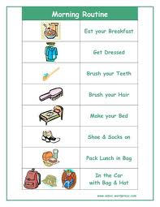
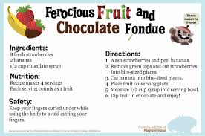
Algorithm

Slide 6
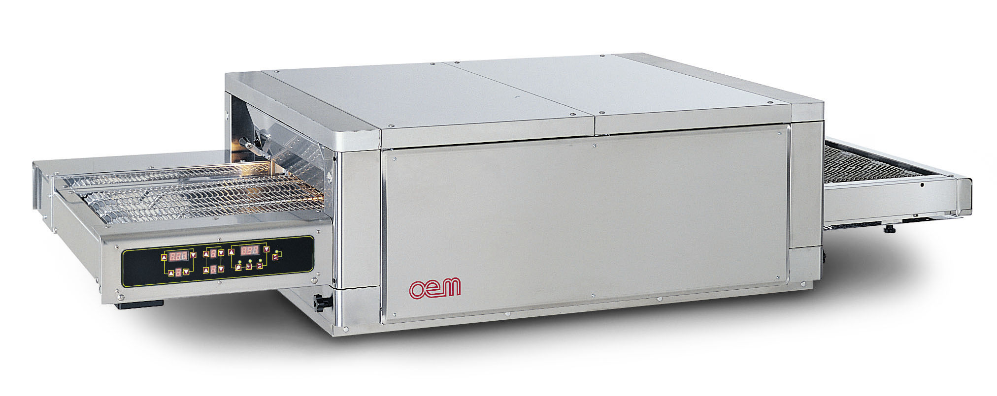
Program

Slide 7
Video
http://studio.code.org/s/course2/stage/1/puzzle/1

Slide 8
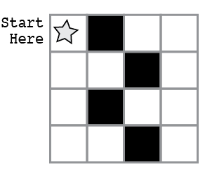
Example – Graph Paper Programming
Talk it out in words: (Algorithm)

Slide 9
Example – Graph Paper Programming
Write Code: (Program)

Slide 10
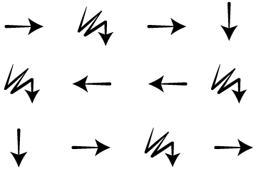
Example – Execute Program

Slide 11
Partner Work
Choose one image on the Graph Paper Programming worksheet.
Write an algorithm.
Turn the algorithm into code.
Swap your program to another group to execute on graph paper.
Check their work.

Slide 12
Computer Time
Login:
Username: bsmedia
Password: (leave blank)
Press enter
Pass out URL/passwords
Open Mozilla Firefox
Type URL: http://studio.code.org/sections/OAOEFV

Slide 13
Computer Time
Click on your name
Enter in your password (Secret Word)
Stage 1: Graph Paper Programming
Click on 1
Answer question
Answer matching question
Stop at Real Life Algorithms: Paper Planes

Slide 14
Exit Slip – Assessment Worksheet
Graph Paper Programming Assessment Worksheet
Read directions
Fill out
Put your name at the top
Turn into me on your way

